Slide 1

Strategic Analytics Initiative Advanced Warehouse Management Systems Curriculum Experiment
Shan Ali Shah Sayed

Slide 2

Analysis Overview
Objectives of the Experiment
Summary of Results
Comparing gains in Proficiency & Application Across Training Program
Effectiveness of Training Programs: Treatment Groups Outperform Control Groups Across Curricula
Recommendations
Experimental Design Analysis
Statistical Analysis
Conclusion
Appendix

Slide 3
Objectives of the Experiment
Participants
593 employees across 6 North American offices
Curriculum Assignments
Curriculum A
Miami, Houston
Curriculum B
Detroit, Denver
Current Curriculum
New York, Los Angeles
Evaluating the effectiveness of two new training curricula (A and B) compared to the Current curriculum.
Measuring the impact on employee performance, using Proficiency Scores and Applications Scores as key metrics.
Provide actionable recommendations on whether Curriculum A or B should be adopted.

Slide 4
Summary of Results
Curriculum A
Proficiency Improvement: 41% – Ideal for boosting technical knowledge.
Application Improvement: 37% – Excels in real-world applications and practical training.
Curriculum B
Proficiency Improvement: 43% – Achieved the highest improvement, best for proficiency-focused training.
Application Improvement: 27% – Lower improvement, less suited for practical applications.
Current Curriculum
Proficiency Improvement: 34% – Moderate improvement, maintains current standards.
Application Improvement: 35% – Good improvement, offering balanced practical outcomes.

Slide 5
Comparing gains in Proficiency & Application Across Training Program
Training Program | Pre-Proficiency Score | Post-Proficiency Score | Pre-Applications Score | Post-Applications Score
A | 0.2939 | 0.6968 | 0.3053 | 0.6816
B | 0.3039 | 0.7314 | 0.3142 | 0.5831
Current | 0.2613 | 0.6006 | 0.2661 | 0.6230
PROFICIENCY SCORE ANALYSIS
Training Program A
Participants showed a significant improvement in proficiency scores, increasing from 0.2939 (pre-treatment) to 0.6968 (post-treatment).
The increase indicates that the program was successful in equipping participants with the necessary skills, outperforming the control group.
Training Program B
Proficiency scores rose from 0.3039 to 0.7314, demonstrating the highest improvement among all groups.
This suggests that Program B delivered superior training outcomes, potentially offering a competitive edge in performance metrics.
Control Group (Current)
Proficiency scores increased from 0.2613 to 0.6006, a smaller improvement compared to Programs A and B.
This highlights the added value of specialized training programs over the current baseline approach.
APPLICATION SCORE ANALYSIS
Training Program A
Application scores increased from 0.3053 to 0.6816, indicating that participants were more capable of applying their skills in practical scenarios after the program.
This reflects the program's effectiveness in bridging the gap between theoretical knowledge and practical application.
Training Program B
Scores decreased slightly from 0.3142 to 0.5831.
The decline may suggest a need to revise or tailor the program’s application-focused components to ensure consistent improvement.
Control Group (Current)
Scores improved modestly from 0.2661 to 0.6230.
While the control group saw gains, the improvement was not as significant as in Program A, underscoring the importance of targeted interventions.

Slide 6
Effectiveness of Training Programs: Treatment Groups Outperform Control Groups Across Curricula
For Curriculum A
Curriculum A
The treatment group outperformed the control group (0.6968 vs. 0.6581), showcasing the program's effectiveness in improving skills.
Curriculum B
The treatment group achieved a significantly higher score (0.7314 vs. 0.6408), making Curriculum B the top performer.
Actionable Insight: Scale Curriculum A to drive consistent performance gains across teams.
Post Treatment | After
Control (treatA=0) | 0.6581
Treatment (treatA=1) | 0.6968
For Curriculum B
Post Treatment | After
Control (treatB=0) | 0.6408
Treatment (treatB=1) | 0.7314
The above tables compare post-treatment scores for control and treatment groups within each curriculum.

Slide 7
Recommendations
Adopt Curriculum A
Balanced Improvement: Curriculum A demonstrates significant improvement in both proficiency and applications scores.
Do Not Adopt Curriculum B
While Curriculum B performs slightly better in proficiency scores, its significantly lower applications scores limit its overall effectiveness.
Replace Current Curriculum
The Current curriculum underperforms compared to Curriculum A in all metrics and should be replaced.
Applications-Oriented: The practical importance of applications scores makes Curriculum A the most suitable choice.

Slide 8



Experimental Design Analysis
Strengths
Pre- and Post-Intervention Data: Enables measurement of curriculum impact on employee performance.
Multi-Location Study: Enhances generalizability by reducing location-specific biases.
Limitations
Non-Random Assignment: Employees grouped by office, introducing potential selection bias.
Parallel Trends Assumption: Assumption remains untested, which may limit the validity of results.
Recommendations
Random Assignment: Randomize participants to training programs to eliminate selection bias.
Include Covariates: Add employee demographics and office-specific factors to the regression models.
Test Parallel Trends: Use intake scores to validate the assumption of consistent pre-treatment trends.

Slide 9
Statistical Analysis
Difference-in-Differences Results
Curriculum B
Interaction Term (treatB:Post): -1.464e+12 (non-significant)
Likely due to multicollinearity or data inconsistencies.
Curriculum A
Interaction Term (treatA:Post): +0.0193 (p < 0.05)
Statistically significant improvement in Proficiency Scores compared to the Current curriculum.

Slide 10
Conclusion
Key Takeaways:
Curriculum A is the best choice for replacing the Current curriculum.
It demonstrates balanced improvements in both Proficiency and Applications Scores, critical for employee performance.
Curriculum B's lower Applications Scores limit its practical application.
Next Steps:
Implement Curriculum A across all offices.
Improve experimental design for future evaluations: randomization, testing parallel trends, and controlling for confounders.

Slide 11

Thank You!

Slide 12
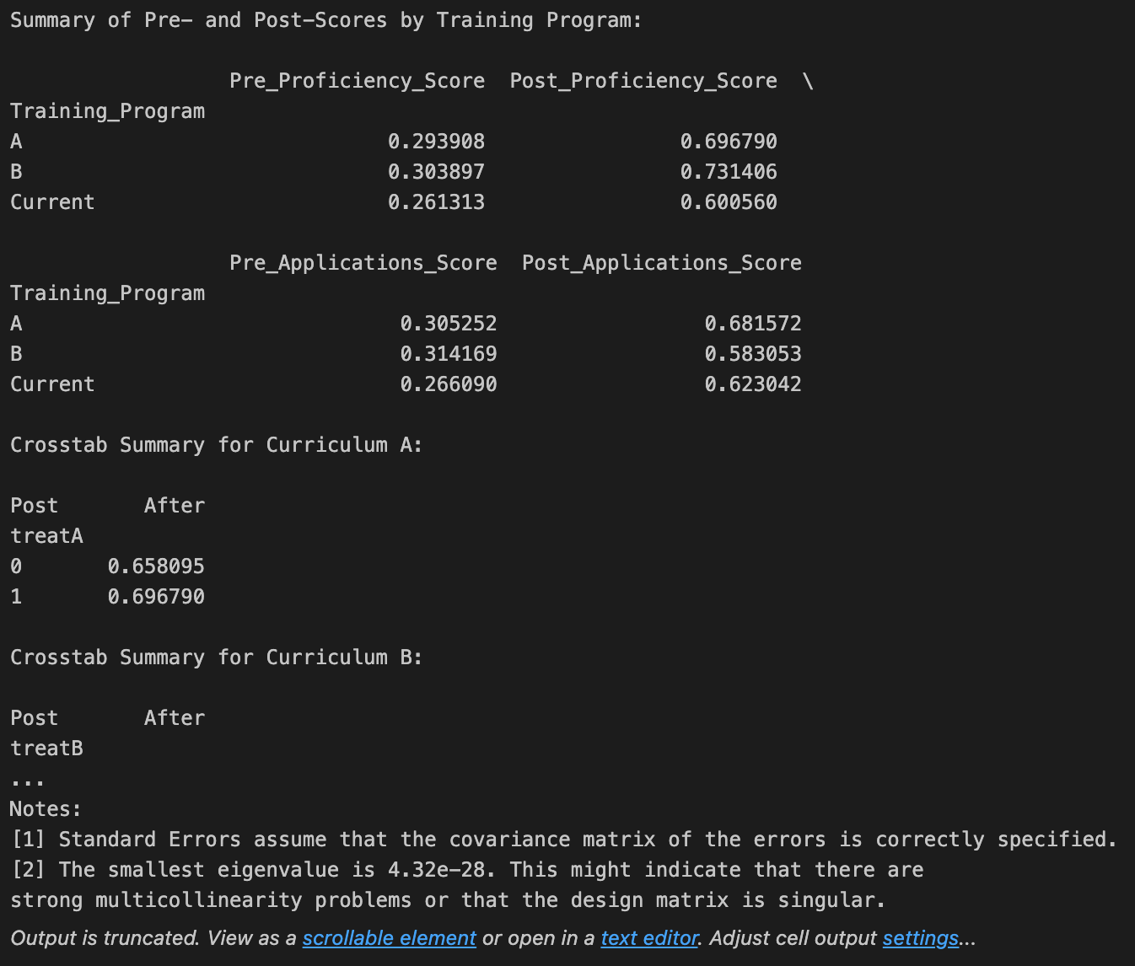
Appendix
Pre and Post Scores of Training Program in Proficiency and Application Training across all 6 locations:

Slide 13
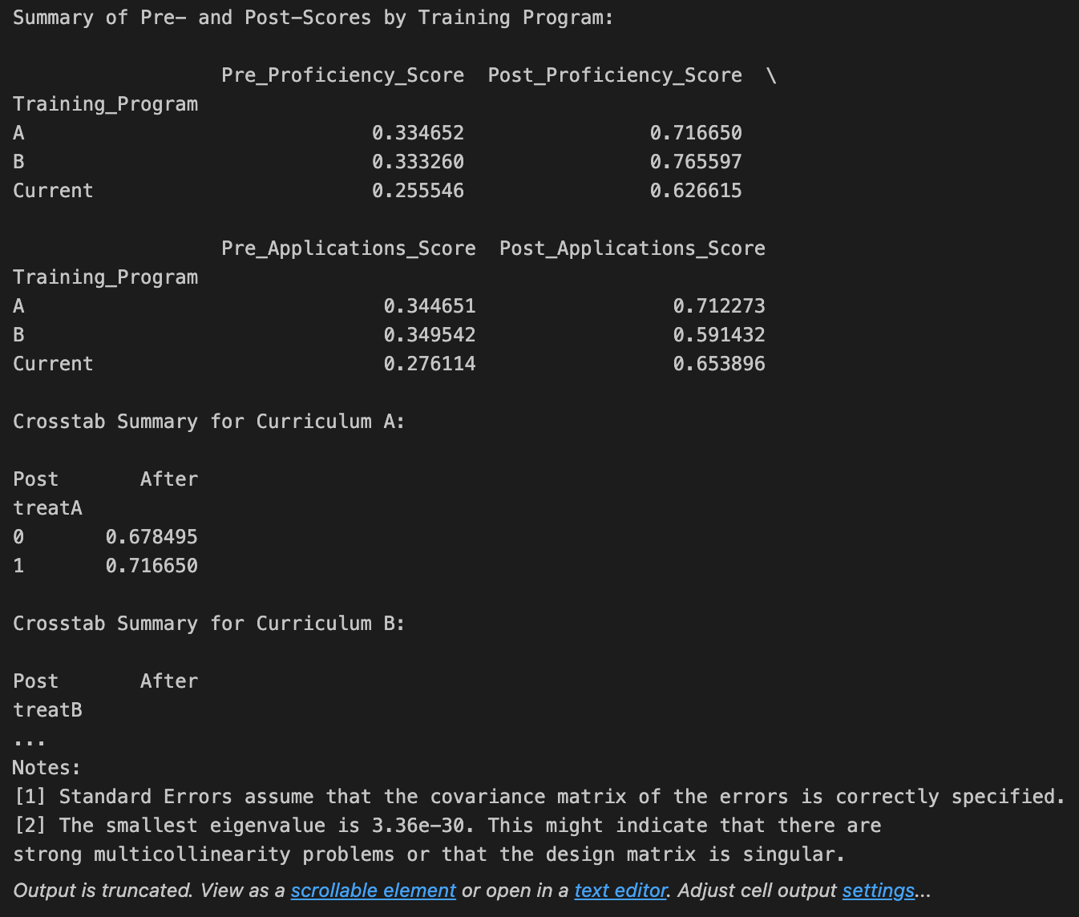
Appendix
Pre and Post Scores of Training Program in Proficiency and Application Training for 3 selected
locations (Los Angeles, Denver, Houston):
Gen AI Usage:
ChatGPT was used to write python code for calculations and to validate analysis results.

